Slide 1
2023 Exemplary Practice
Awards

Slide 2
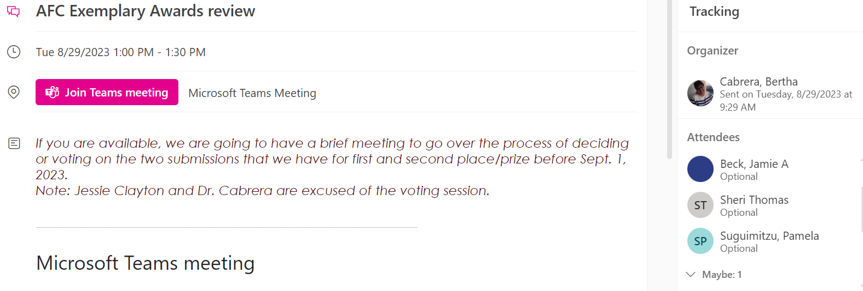
OFFICERS MEETING

Slide 3
Evaluation
Exploring Possibilities through VR Tutoring
WeLearn 366 Institute
Eval. | 1 | 2 | 3 | 4 | 5 | 6 | 7 | 8 | total
1 | 10 | 20 | 15 | 4 | 5 | 15 | 10 | 10 | 89
2 | 10 | 20 | 20 | 5 | 5 | 15 | 10 | 10 | 95
3 | 10 | 16 | 20 | 5 | 5 | 16 | 8 | 10 | 90
4 | 10 | 20 | 20 | 5 | 5 | 18 | 10 | 10 | 98
Eval. | 1 | 2 | 3 | 4 | 5 | 6 | 7 | 8 | total
1 | 10 | 20 | 20 | 2 | 5 | 20 | 10 | 10 | 97
2 | 10 | 20 | 20 | 5 | 5 | 20 | 10 | 10 | 100
3 | 10 | 20 | 20 | 3 | 5 | 20 | 10 | 10 | 98
4 | 10 | 16 | 20 | 5 | 5 | 20 | 10 | 10 | 96

Slide 4
Final
Evaluation | Exploring Possibilities through VR Tutoring | WeLearn366
1 | 89 | 97
2 | 95 | 100
3 | 90 | 98
4 | 98 | 96

Slide 5
Graphic

Slide 6
First Place WeLearn366 Institute Miami Dade College, Padron Campus AFC Exemplary Practice: Technology Commission Submission Dr. Belkis L. Cabrera, MDC WeLearn Director
The AFC Technology Commission would like to thank everyone who submitted their exemplary practice for recognition of the 2023 award. After a close review and consideration, the review committee has chosen to recognize the following outstanding submissions:
Theme: “Moving Forward to Creative & Innovative ways of using Technology in Education”
The WeLearn 366 Institute is an equity-focused grant initiative that strives to improve retention, progression, and completion rates for Hispanic and low-income students. WeLearn offers a vibrant, innovative, and high-tech workspace that prioritizes course redesign, student wrap-around services, and diverse opportunities for planned and organic collaborations among students, staff, and faculty.

Slide 7
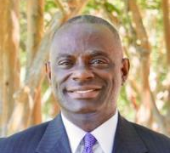
Second Place Exploring Possibilities through Virtual Reality Tutoring - Tallahassee Community College AFC Exemplary Practice: Technology Commission Submission Sam DeZerga, TCC Learning Commons Director & Jessie Clayton, TCC Learning Commons Technology Specialist
Since January 2020, the TCC Learning Commons has partnered with Study Edge to pilot the use of virtual reality (using Oculus Quest 2 headsets) in learning centers. Virtual reality (VR) enables users to experience 3D rendered environments in both physical and virtual spaces. VR creates a sensory experience: sights, sounds, haptics, that allow the user to interact with alternate realities.
To date, hundreds of current and prospective students have used the VR headsets and considered its applications within the educational environment. Success coaches have utilized VR headsets to offer coaching sessions on a variety of topics including stress management, goal setting, mindset work, and motivational strategy.

