Slide 1
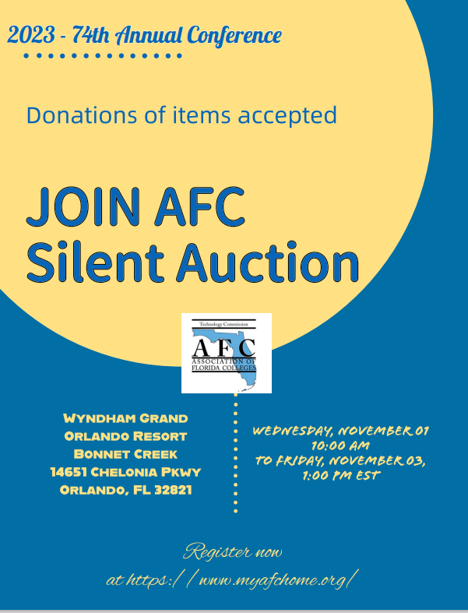
NEWSLETTER
AFC Technology & Region I presenters participating on 3/31/2023 to continue trend
Participating in the Food Drive for Region V on 4/14/2023 announcement to start the collection of cans and non-perishable food to fight hunger in America.
Fundraising for the Region V Commission meeting on 4/14/2023.
Donations accepted for the Silent Auction on 11/3/2023.
The commission is calling for Donations to the AFC Leadership meeting on 1/25-1/27/2023.
Two positions open for the Historian and the Webmaster
Dr. Belkis L. Cabrera
Bertha Cabrera
The Technology commission strives to participate in new technology workshops.
Last year ‘s winner received a certificate of recognition & $150 check for participating and winning first place.
The Unsung Hero between the officers elected: Dr. Belkis L. Cabrera.
This year Exemplary Practice Award due Aug.1.
The Distinguished officer voted by the board members: Jamie Beck.

