Slide 1
AFC TEchnology Exemplary Practice Award
By Bertha Cabrera

Slide 2

Award Announcement
DEADLINE EXTENDED TO AUGUST 1ST TO GIVE US AMPLE TIME TO RECEIVE NOMINATIONS.
THE PROCESS OF APPLYING AND BEING READY TO PRESENT HAS BEEN INCORPORATED IN ONE STEP.
THE OFFICERS WILL ACT TO SELECT THE FIRST AND SECOND PRIZE WINNER FROM THE SUBMISSSIONS RECEIVED IN A TIMELY MANNER.
ANNOUNCEMENT CAN BE PART OF THE LAST REPORT PRIOR TO THE ANNUAL CONVENTION.
NOMINEE AND/OR REPRESENTATIVE MUST BE PRESENT AT THE ANNUAL CONVENTION.

Slide 3
STEPS
Get the approval from your immediate supervisor, campus and/or college president
Be ready to attend the Annual Conference
Have a PP with the submission and/or visual media
Pay attention to the deadline for a timely submission
​Any questions or concerns that you might have, we can discuss your proposal prior to your pitch or participation in terms of what you are considering to present, or you can just apply and submit it to be evaluated.

Slide 4
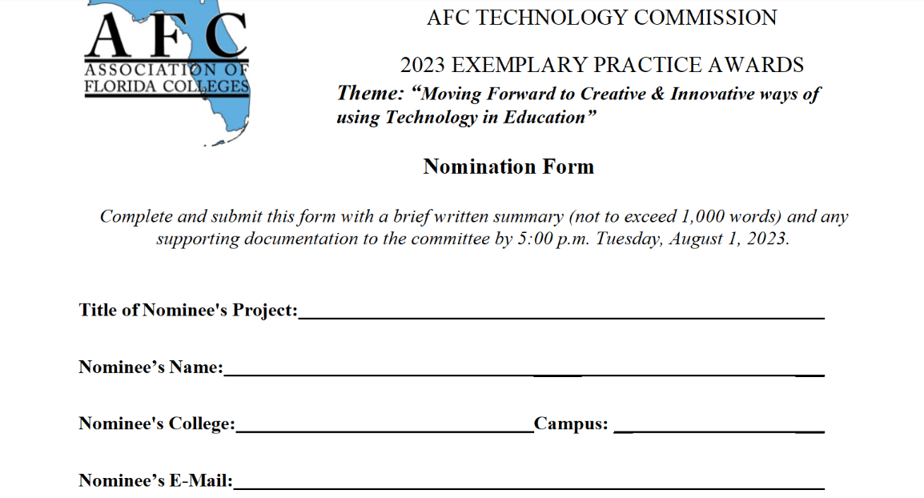
Nomination form

Slide 5
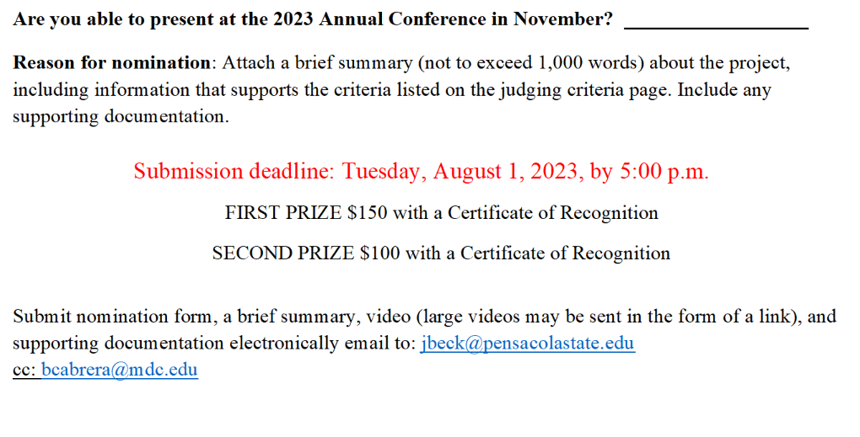
continue

Slide 6

Evaluation criteria

Slide 7
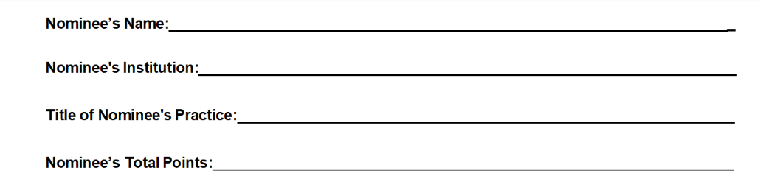
continue

Slide 8
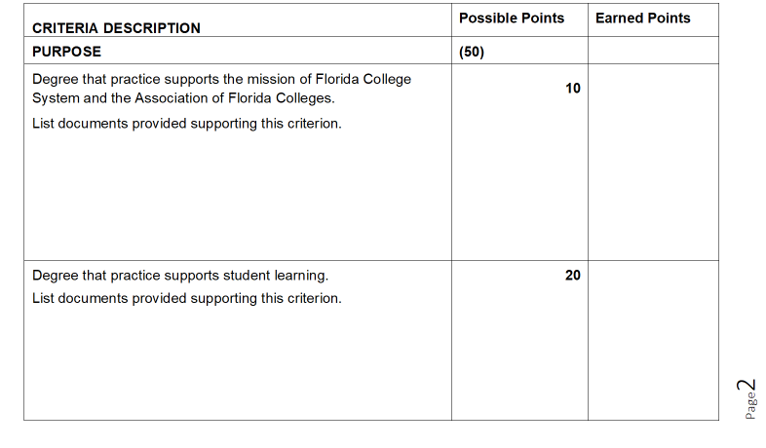
Listed description/purpose

Slide 9
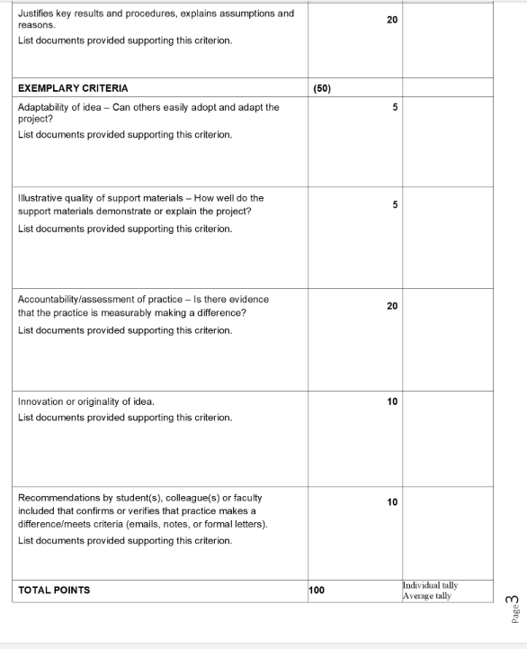
continue

Slide 10
SUMMARY
This yearly award represents our goal to contribute to the promotion of technology mainly in education.
We welcome your suggestions and comments about this award starting with the Theme and Scope selection between the officers that can include members.
Marketing tools we are using to distribute this information:
Via email, in person appearances during regions and meetings, website Weebly (local) and statewide, word-of-mouth, social media, during annual conference, reports, and other gatherings.

Slide 11
Contact us
https://afctechnologycommission.weebly.com/proposal-for-the-afc-commission-of-the-year-2023.html
https://www.myafchome.org/technologycommission

