Slide 1
LibGuide vs Weebly
By Bertha Cabrera
AFC Technology Commission Secretary​

Slide 2
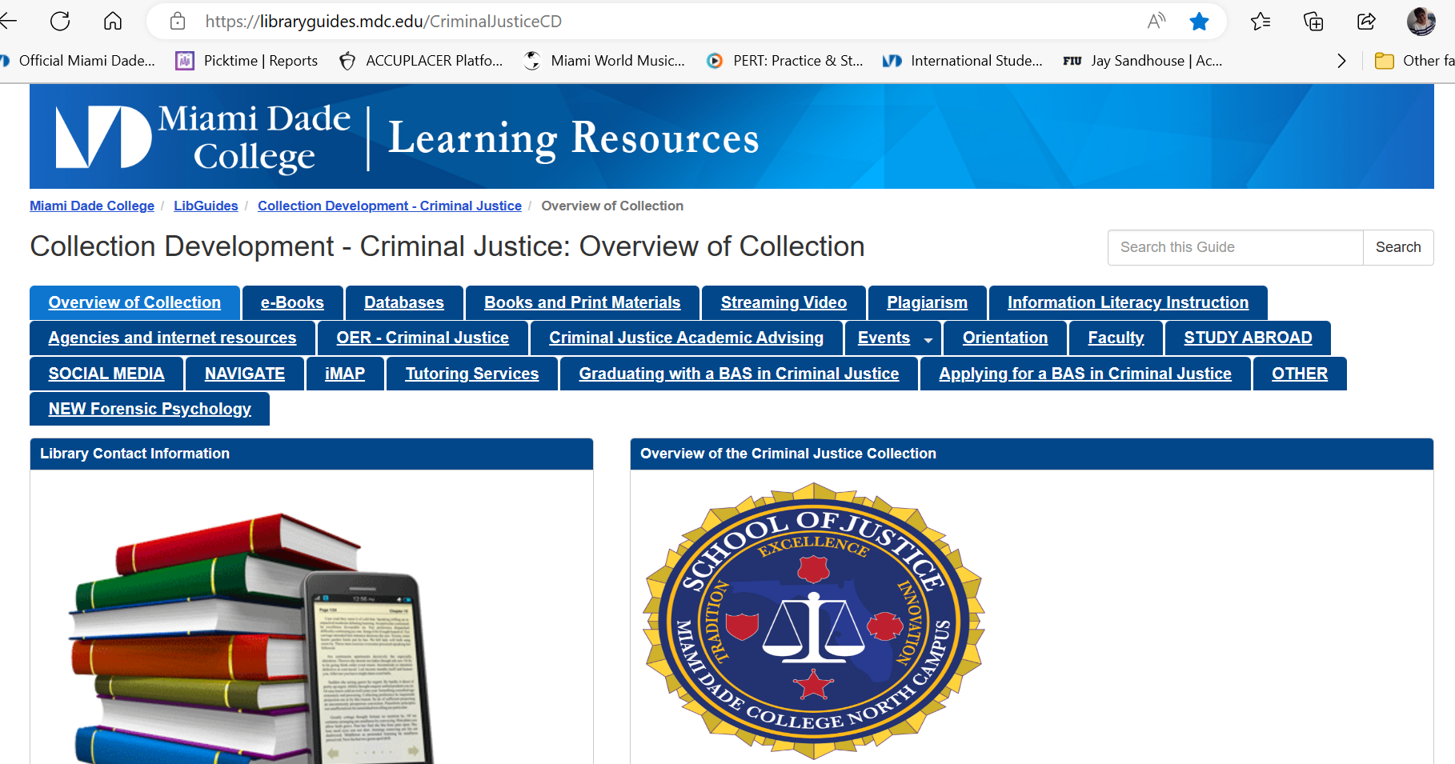
Libguide

Slide 3
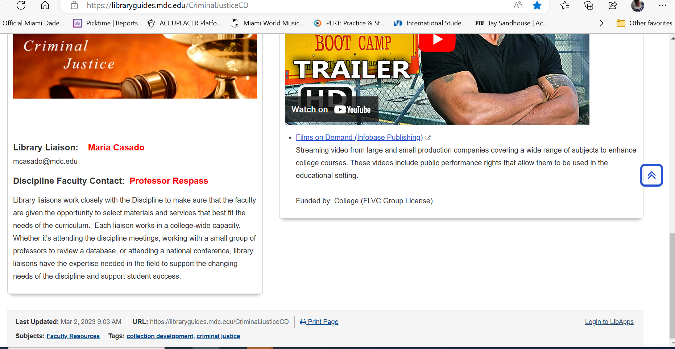
Sign in

Slide 4
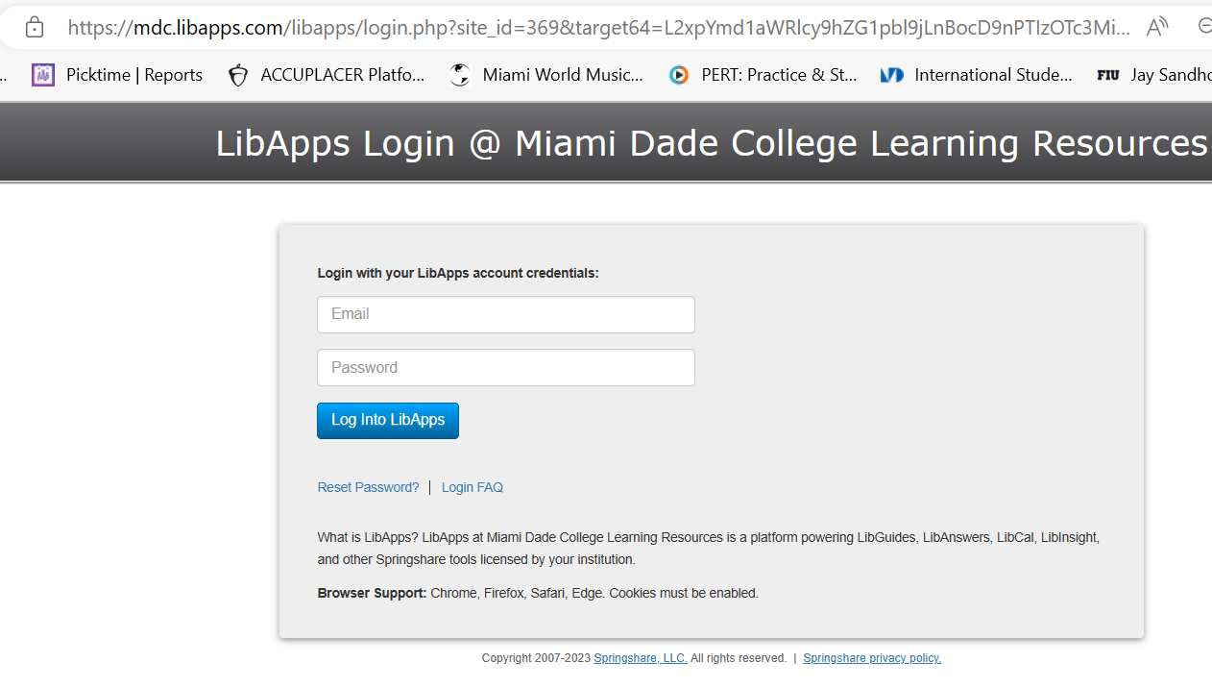
USE YOUR CREDENTIALS

Slide 5
Add from the menu

Slide 6
Insert rich text/image

Slide 7
INSERT IMAGE/SAVE

Slide 8
Resources
https://afctechnologycommission.weebly.com/uploads/5/4/3/7/54376519/libguideberthacabrera2.pdf
https://libraryguides.mdc.edu/CriminalJusticeCD
https://libraryguides.mdc.edu/eapservices
https://libguides.com.edu/research
https://ask.springshare.com/libguides/faq/849

Slide 9
Weebly
Sign in/sign up
Edit site

Slide 10
BUILD TAB

Slide 11
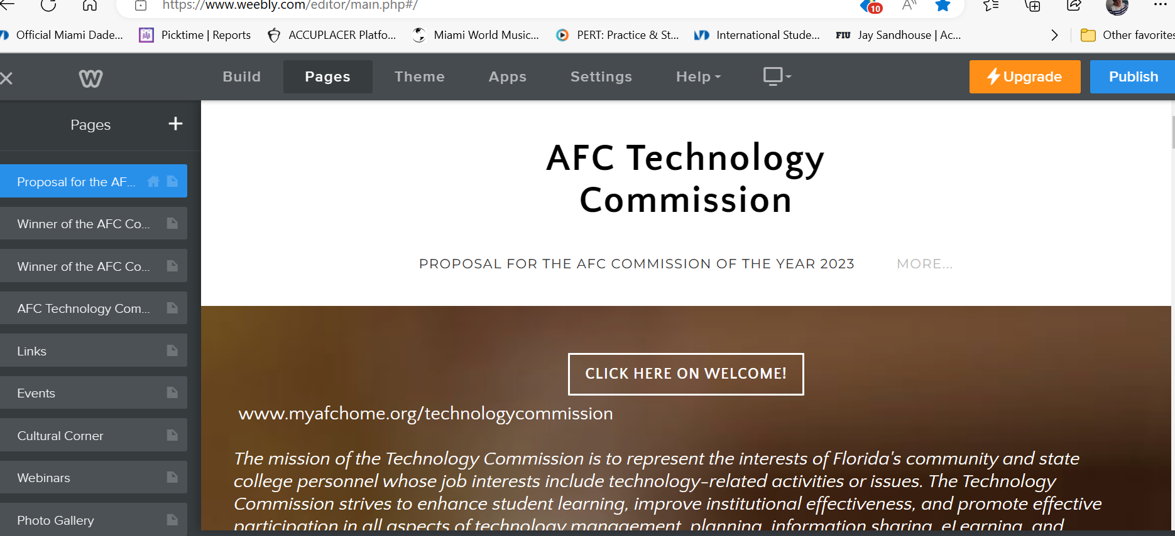
PAGES TAB

Slide 12
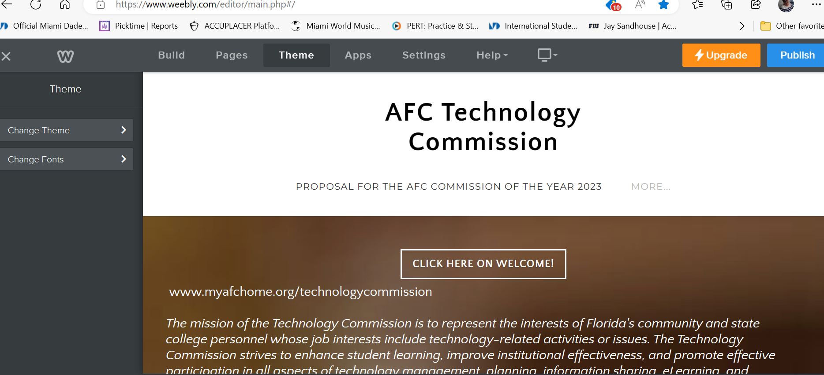
theme tab

Slide 13
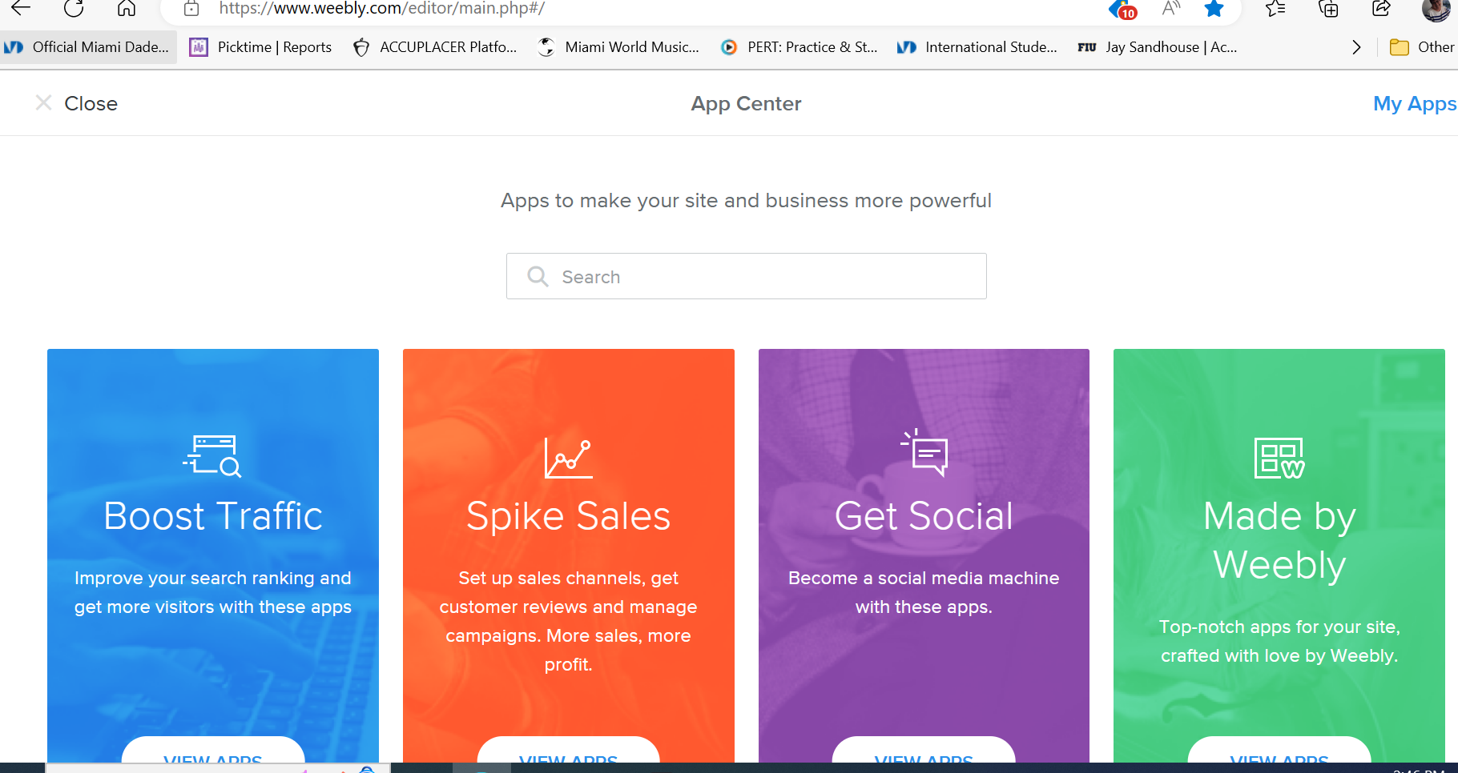
App center tab

Slide 14
Settings tab

Slide 15
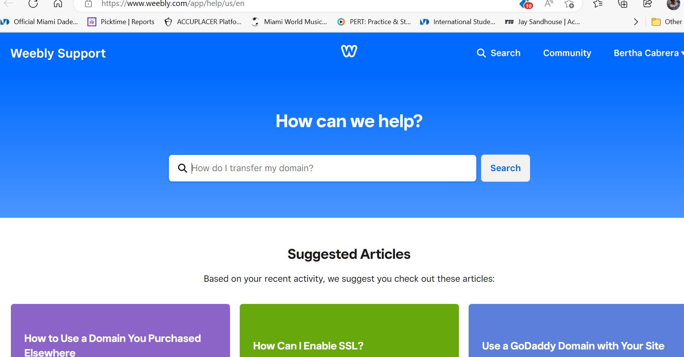
help tab

Slide 16
Resources
https://www.webcreate.io/
https://www.squarespace.com/
https://www.squarespace.com/websites-start/
https://www.squarespace.com/website-design/
https://afcmembershipdevelopment.weebly.com/
https://afctechnologycommission.weebly.com/
https://mdcsojinfo.weebly.com/
https://eapsupportlab.weebly.com/

Slide 17
COMPARISON

Slide 18
Q & A
Any questions?

Slide 19
About LibGuide
When was the LibGuide created/founded?
Since 2007 by Slaven Zivkovic (origin of surname, Austria) a library assistant graduate of Santa Clara University, CA who founded the Springshare platform in N.Y. based in Miami, Florida for library and educational purposes.
Which servers work best with this platform?
Google Chrome, FireFox, and Microsoft Edge.
What is the advantage of using LibGuides?
Accessible 24/7/365 just give your students the URL-Uniform Resource Locator
Social Media capabilities with networks, wikis, and blogs
Easy to use podcasts, social bookmarking, and other apps.
New feature LibCal for scheduling of library calendaring needs.

Slide 20
About Weebly
When was the Weebly created/founded?
Since 2006 by Chief Executive Officer David Rusenko, Chief Technology Officer Chris Fanini, and former Chief Product Officer Dan Veltri. Rusenko and Fanini both attended the College of Information Sciences and Technology at Pennsylvania State University (Penn State). Acquired by Square in 2018.
Which servers work best with this platform?
Google Chrome
What is the advantage of using Weebly/Square?
Accessible 24/7/365
Free version to upgrade to Premium for $10 a month
Good templates offered
Mobile App. available

