Slide 1
Pivot Table tutorial
From Excel Tutorial By Bertha Cabrera

Slide 2
Pivot Table Steps
Page 1 Example of Step 1
Page 2 Example of Step 2
Page 3 Example of Step 3
Pagae 4 Example of Step 4
Comparison of Tables
Step 1 Convert to Pivot Table
Step 2 Select Fields
Step 3 Select Filters
Step 4 Prepare Graphs

Slide 3
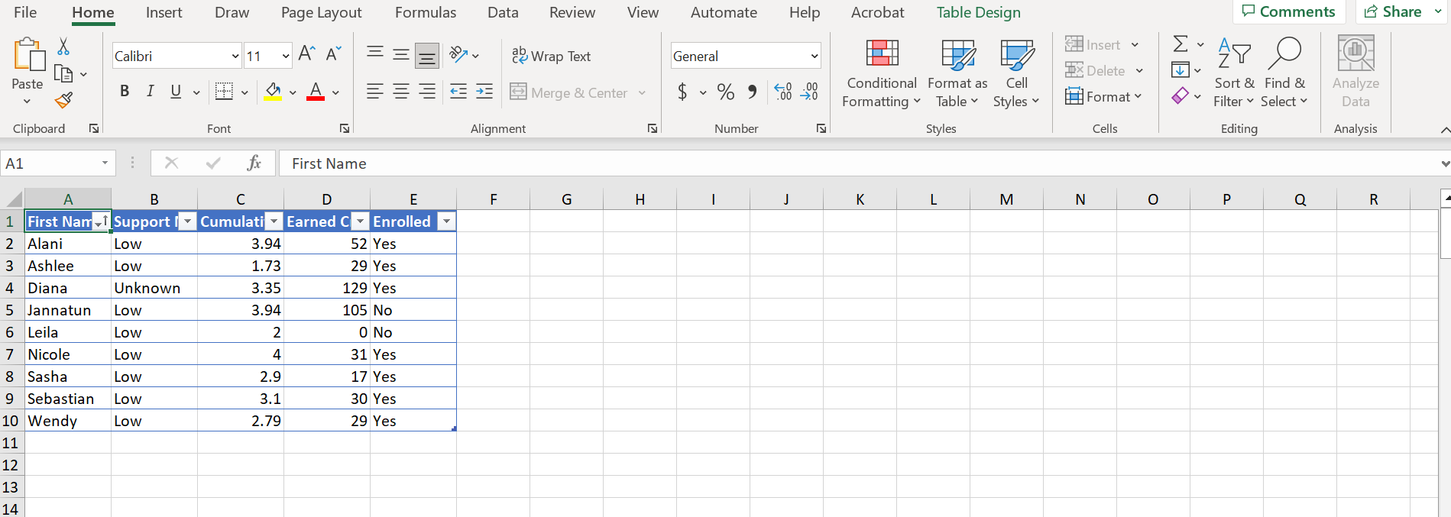
Excel Table

Slide 4
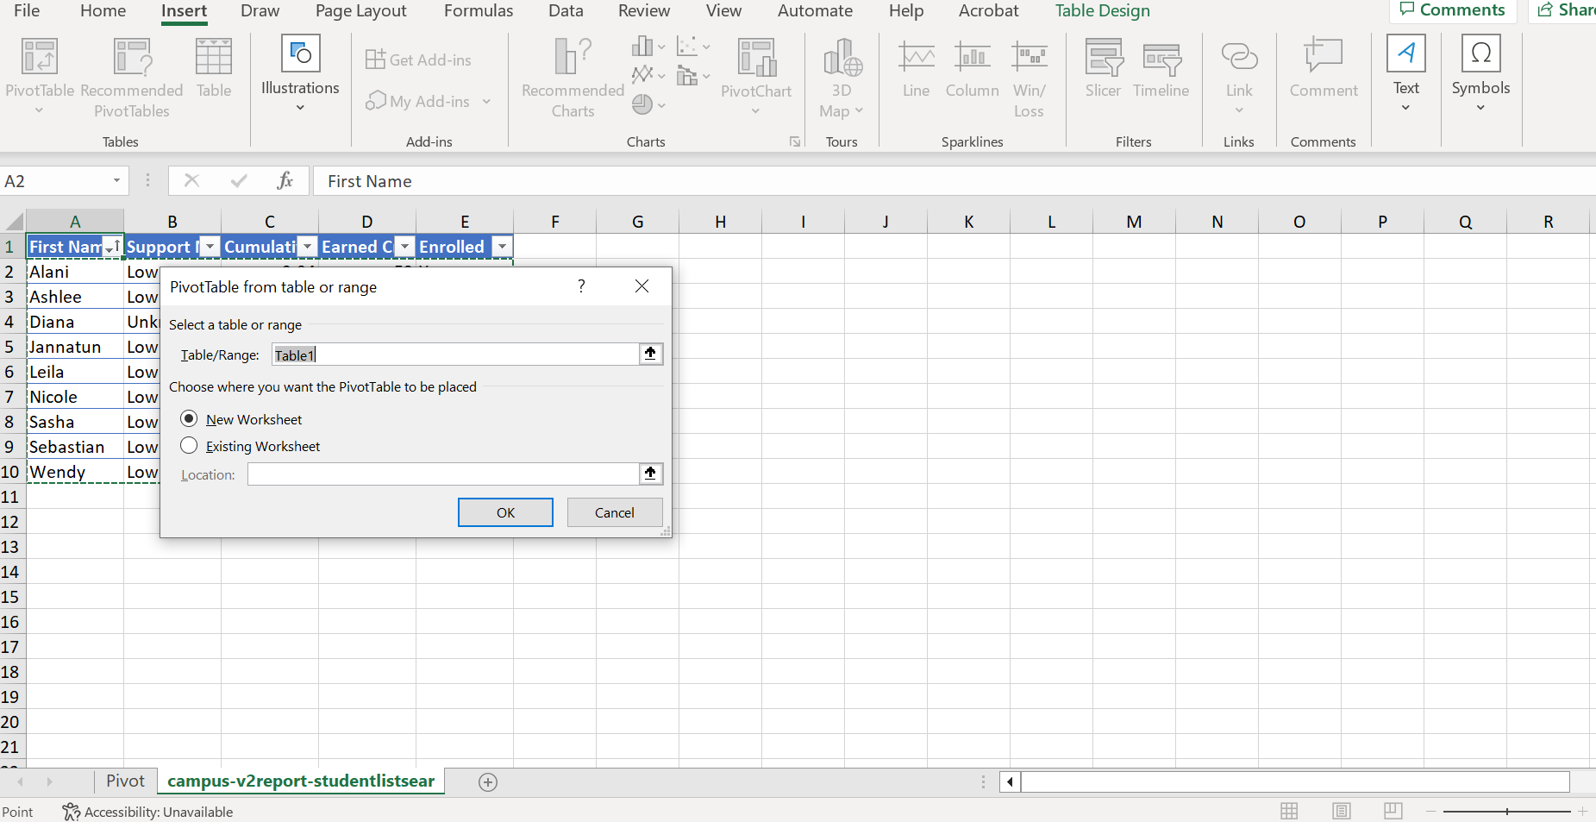
Insert Pivot Table

Slide 5
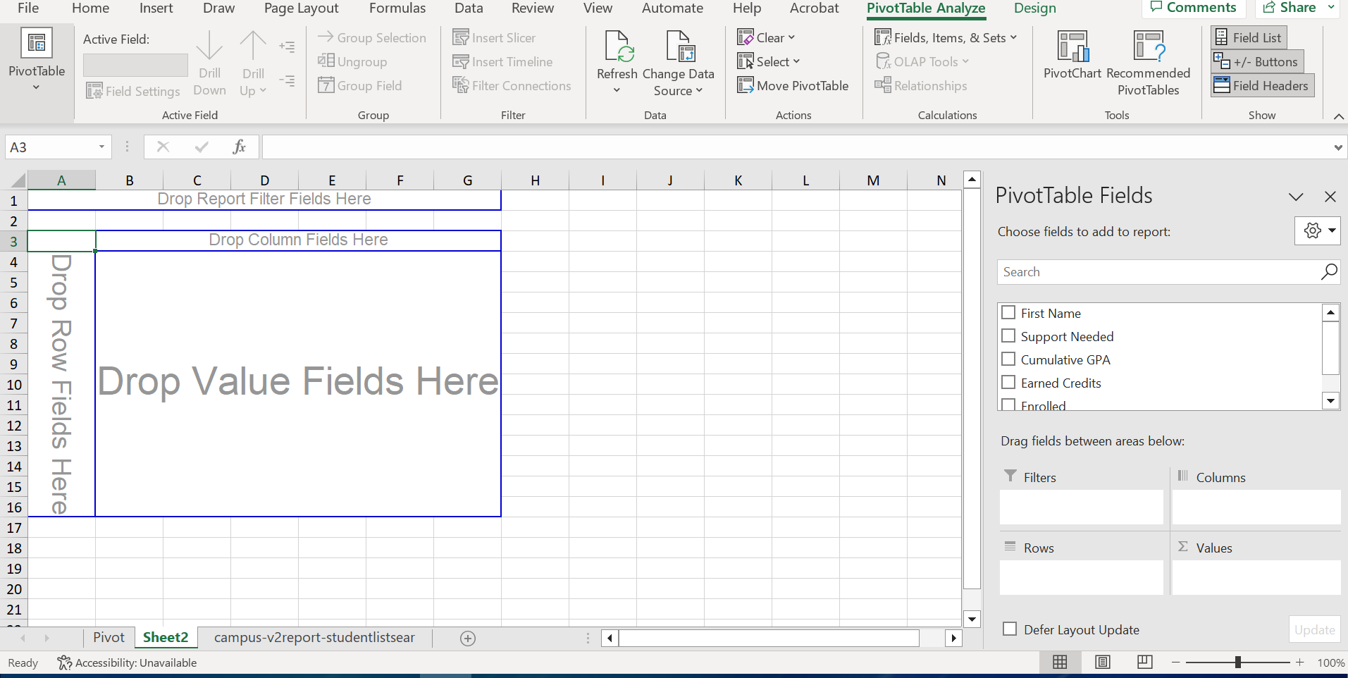
Pivot Table Created

Slide 6
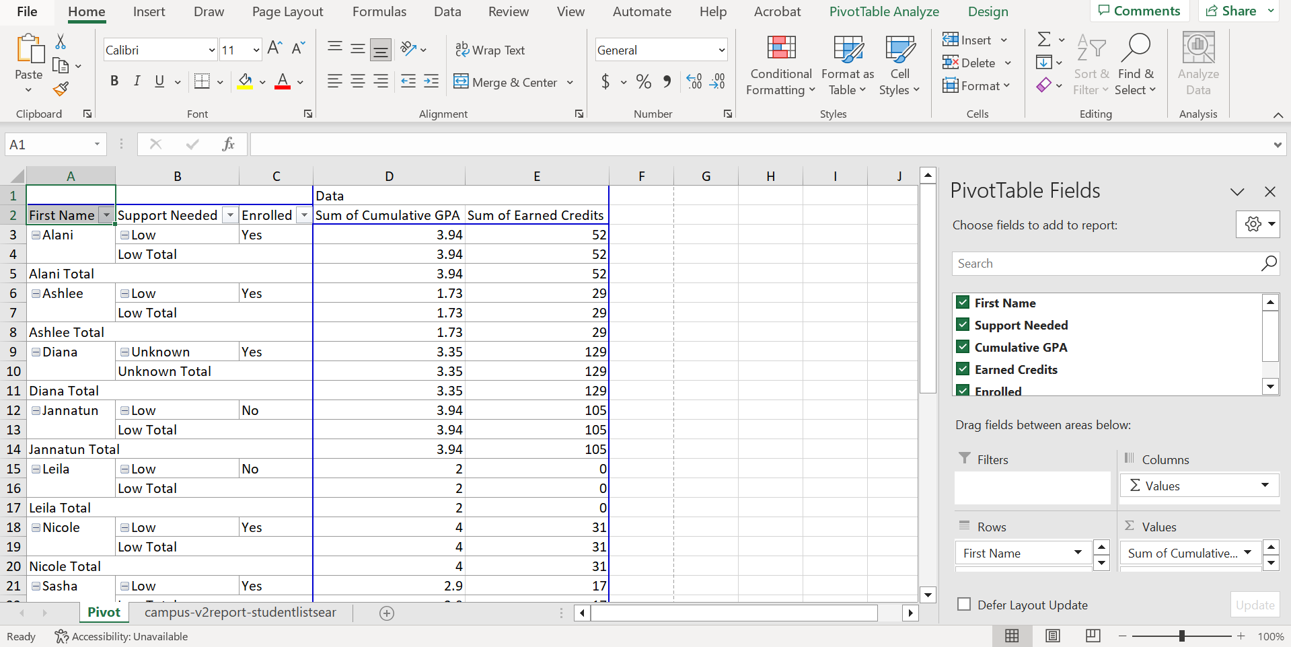

Slide 7
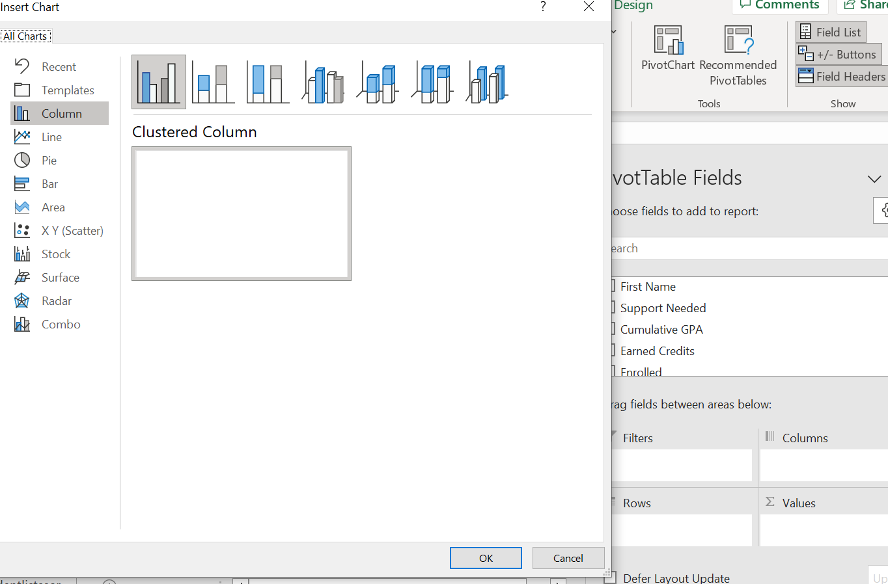
Pivot Chart-Graph in Pivot Table

Slide 8
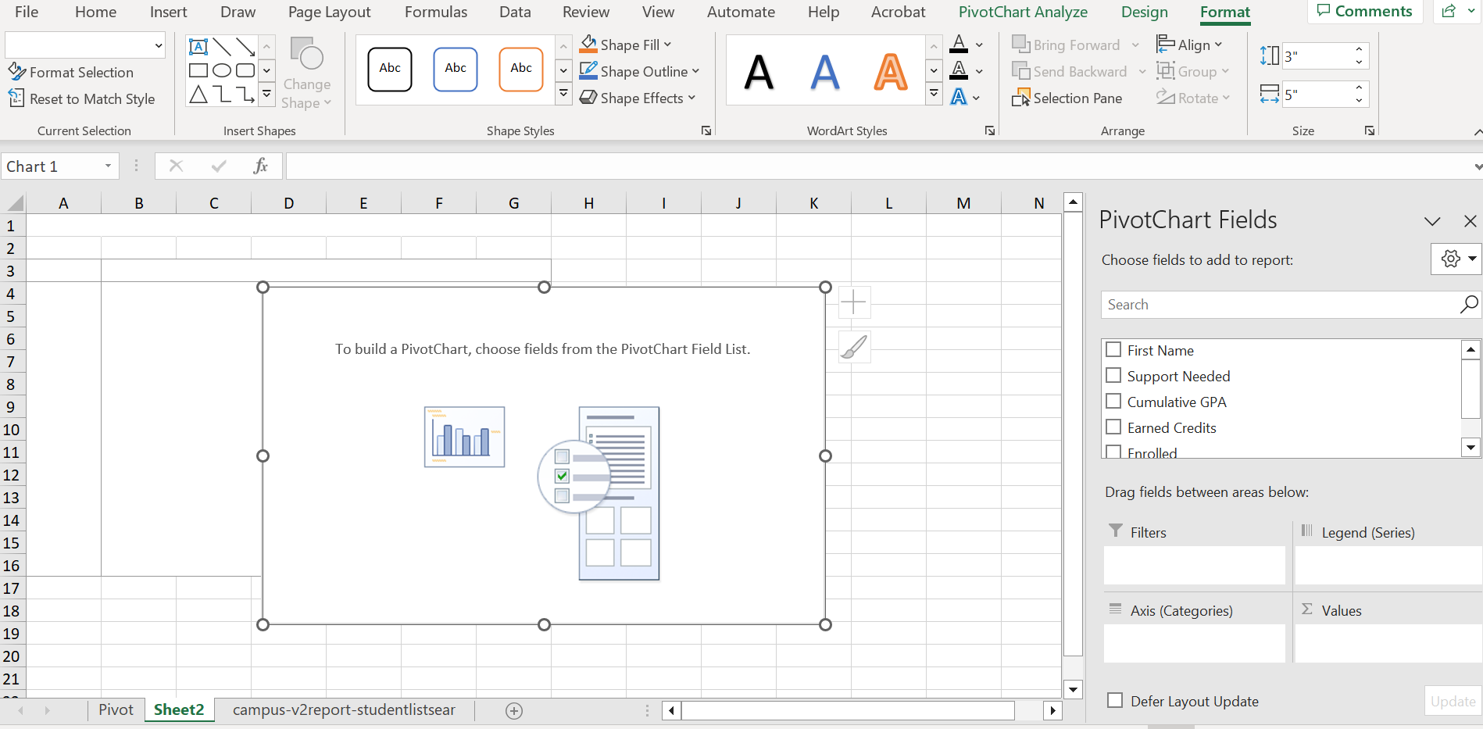
Make your Selections

Slide 9
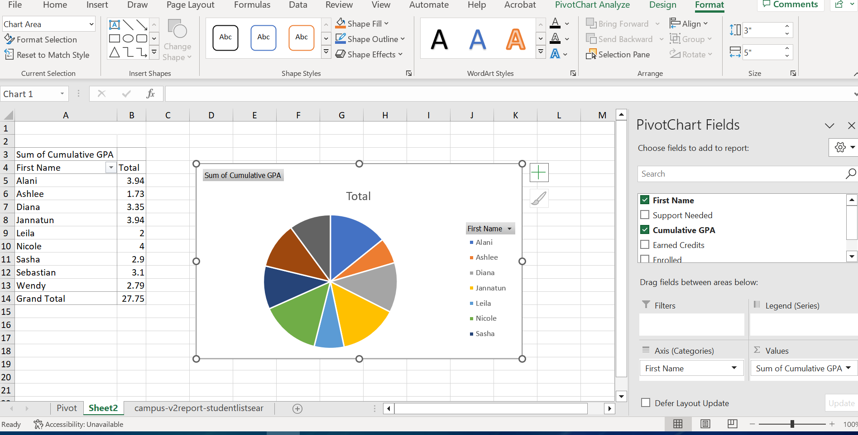
Chart & Fields

Slide 10
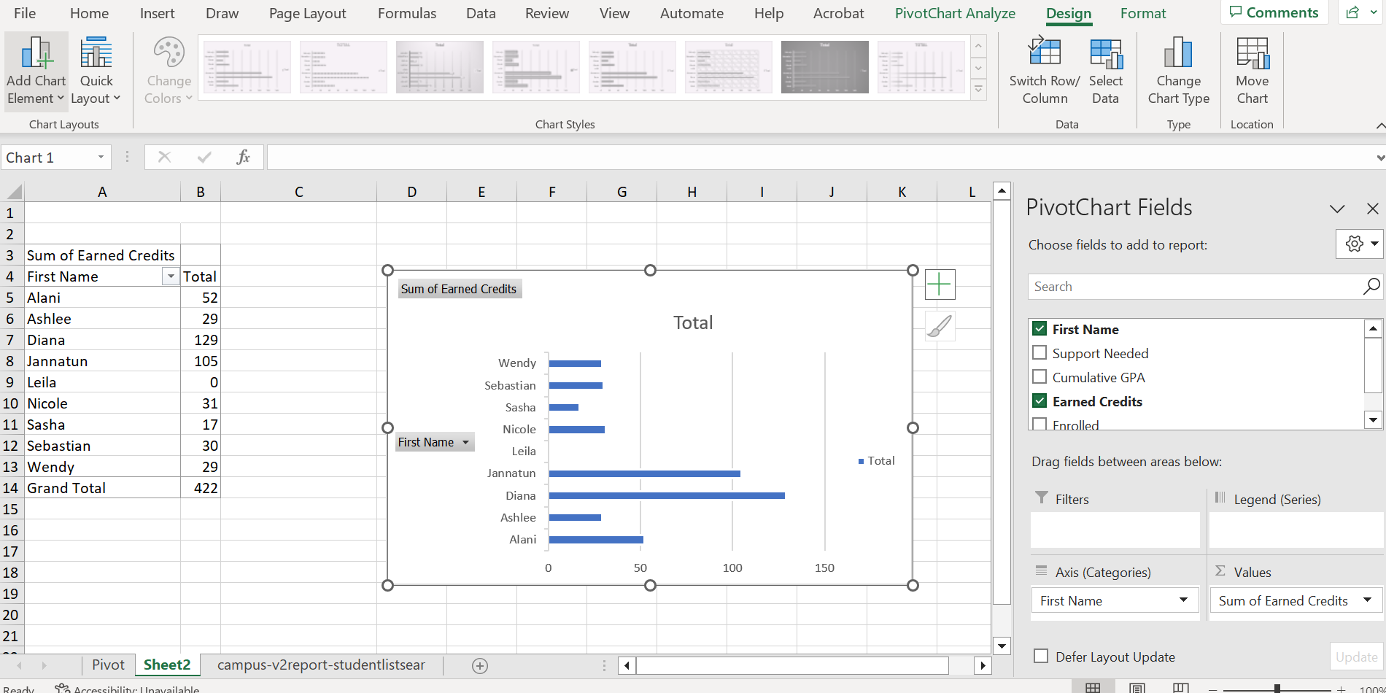
Change Chart & Fields

Slide 11
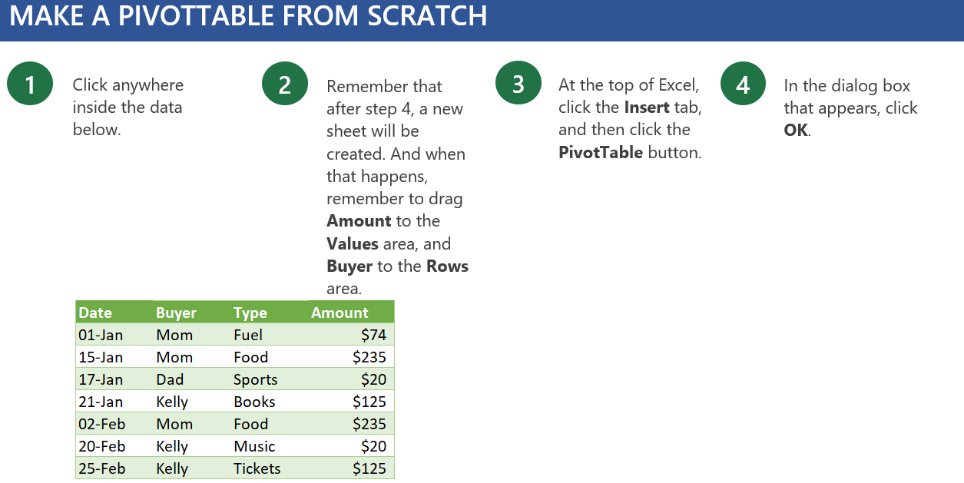
Convert Excel Table to Pivot Table

Slide 12
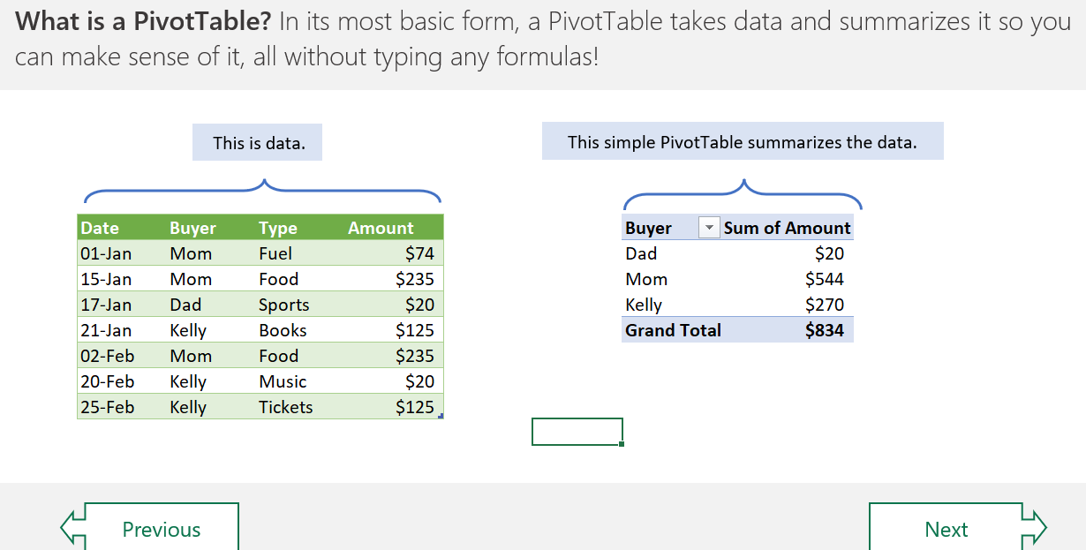
Select Fields for Pivot Table

Slide 13
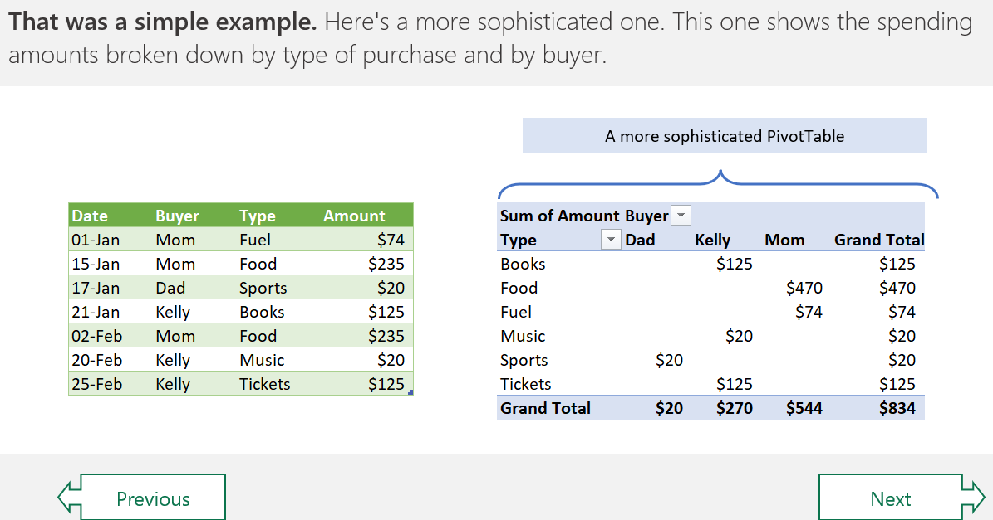
Select Filters for Pivot Table

Slide 14
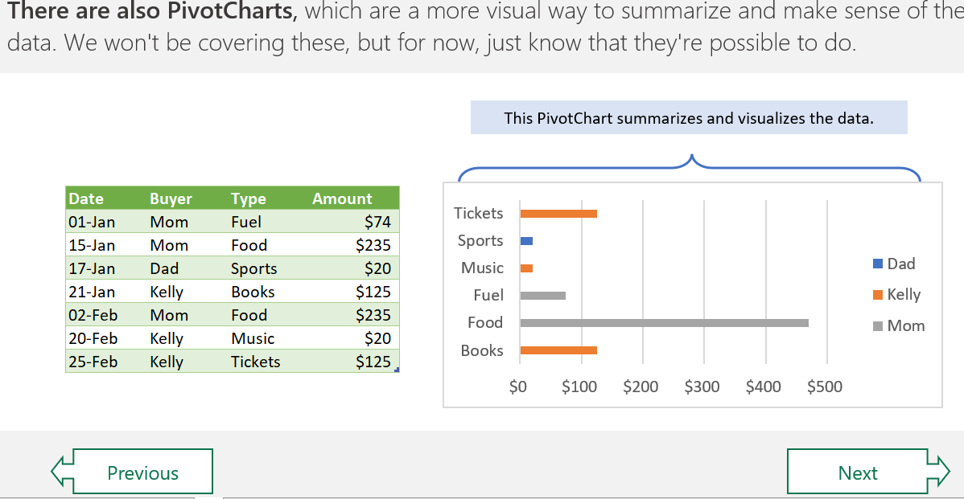
Pivot Charts

Slide 15
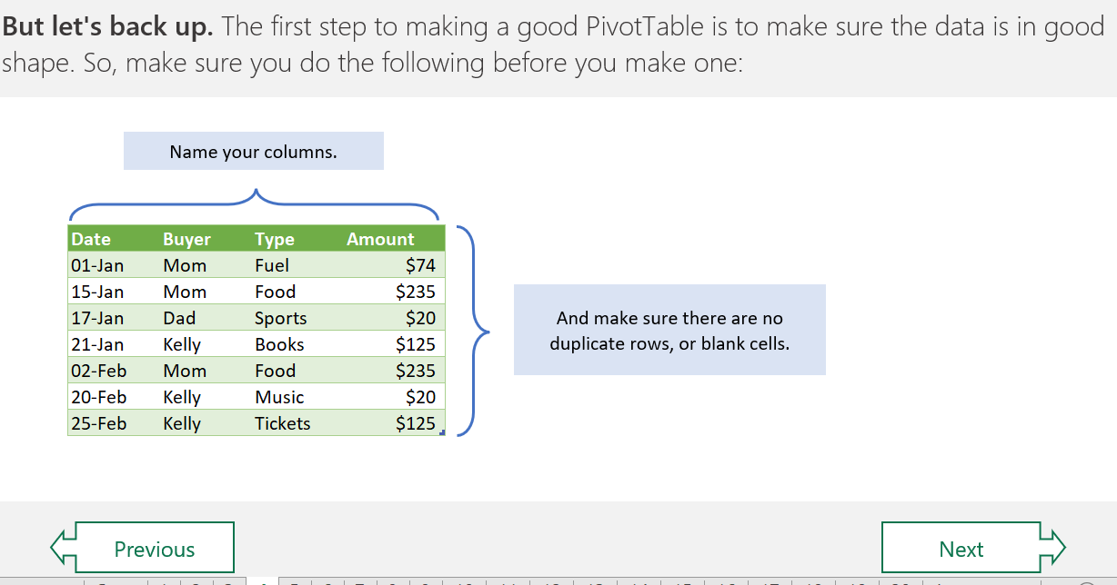
Follow a Sensible Sheet

Slide 16
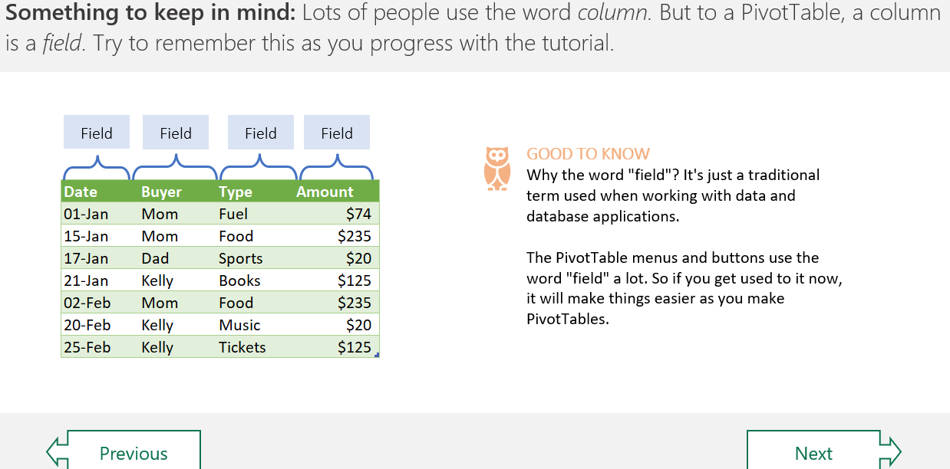
Fields

Slide 17
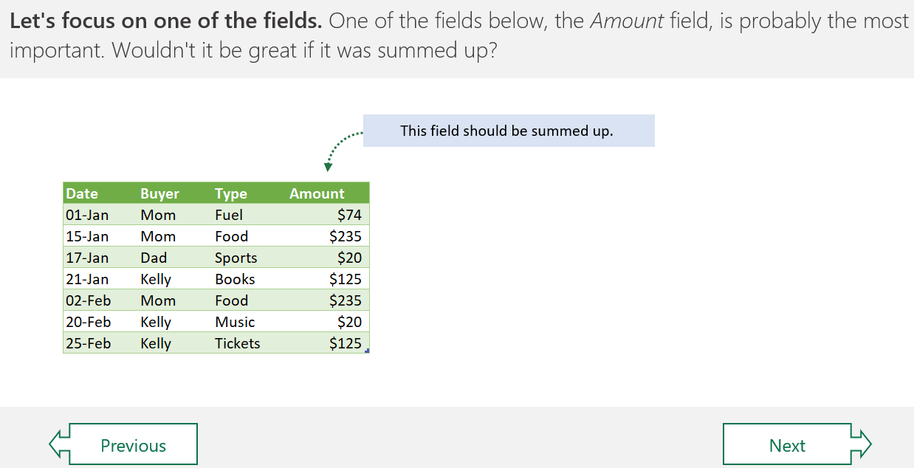
Spell Out the Names

Slide 18
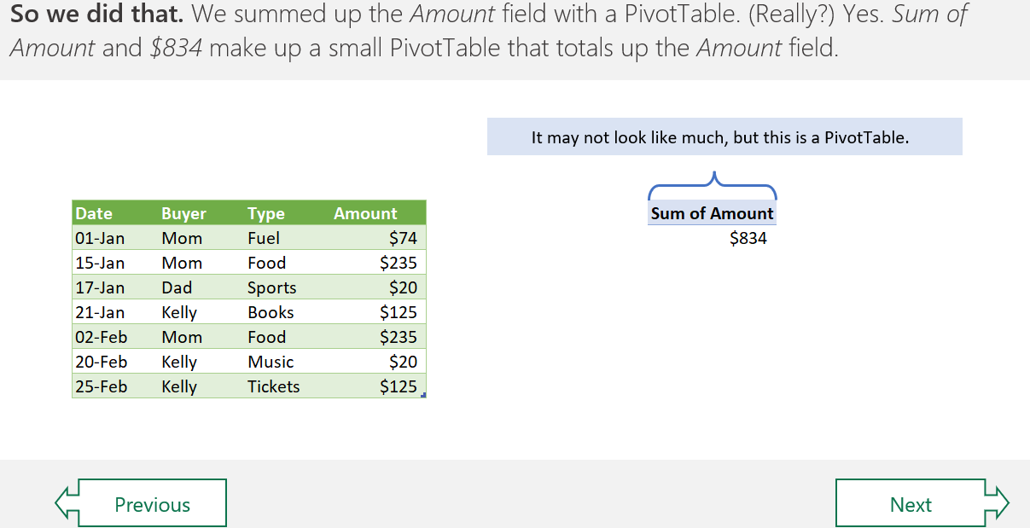
Small Pivot Table

Slide 19
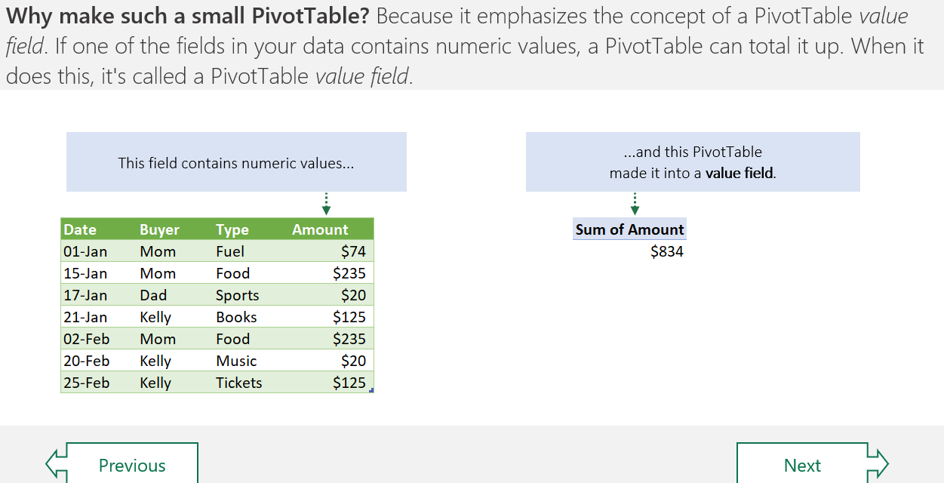
Continue

Slide 20
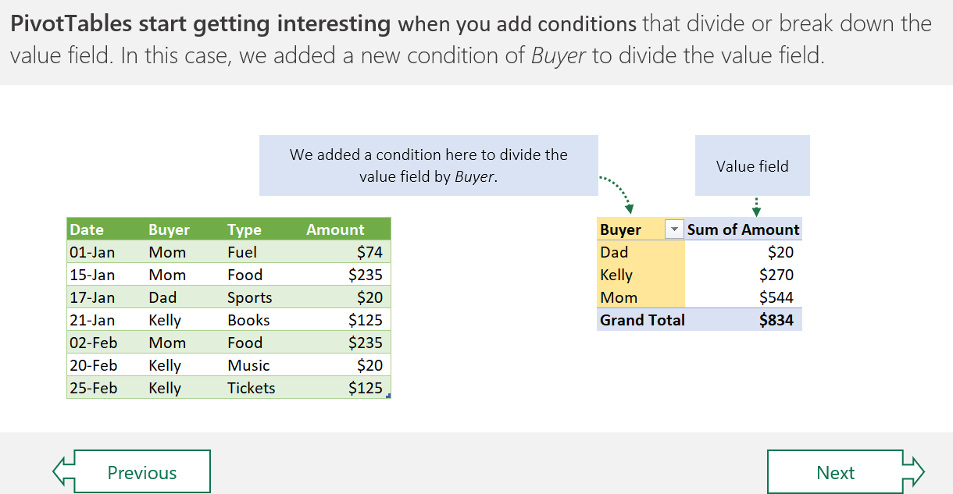
Add Conditions

Slide 21
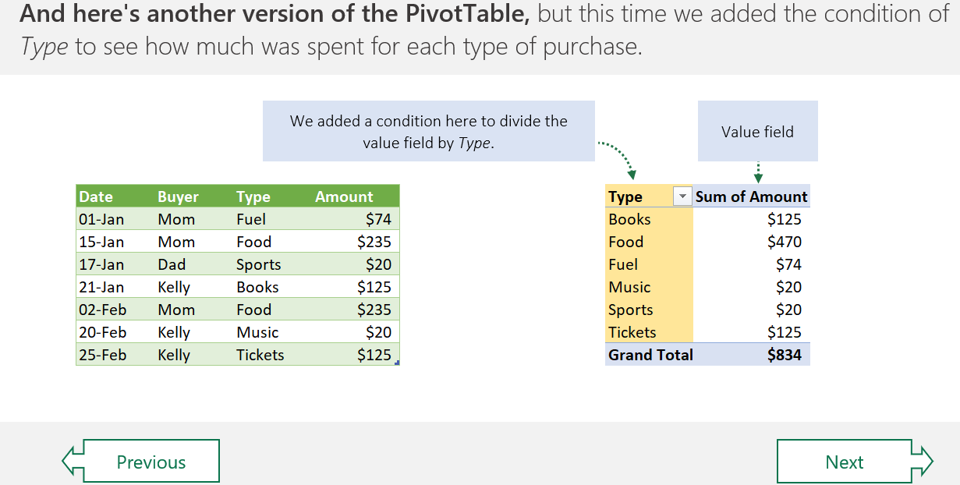
Type

Slide 22
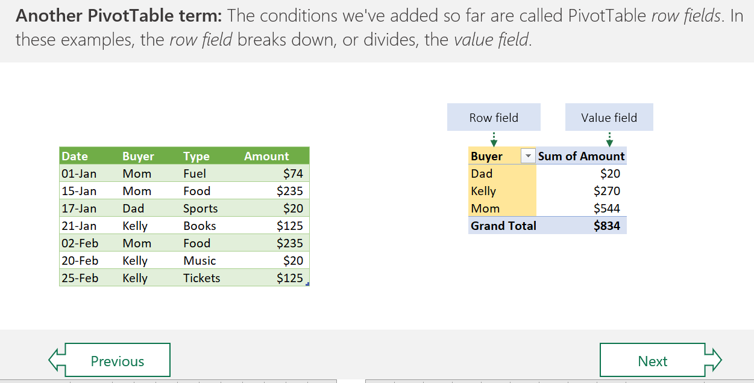
Row Fields

Slide 23
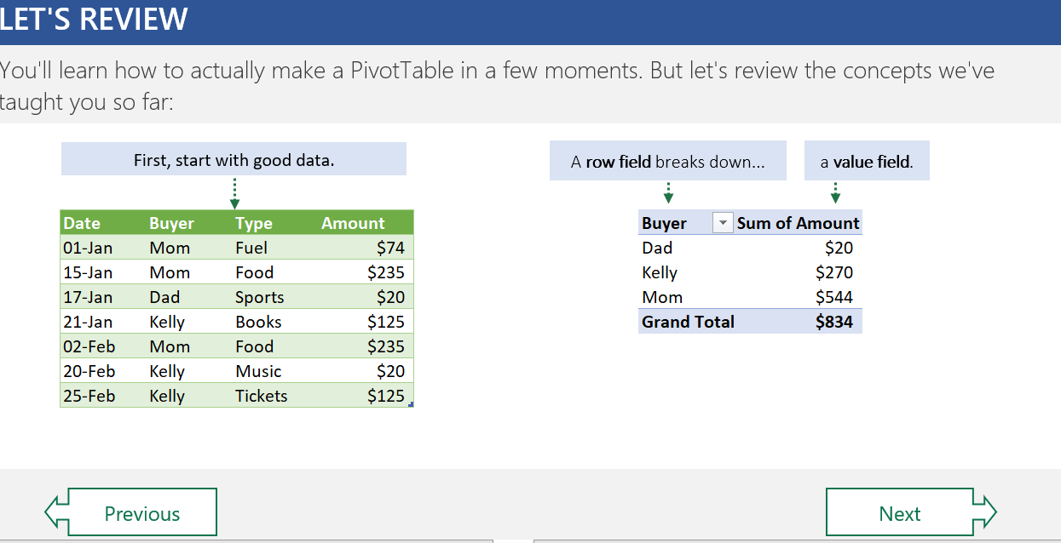
Review

Slide 24
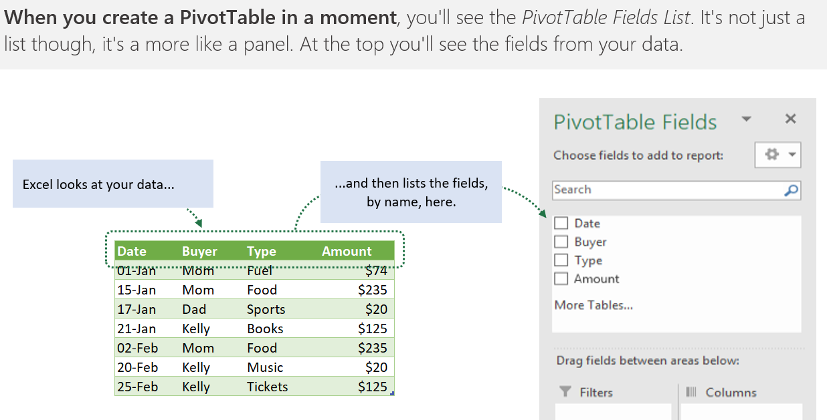
Panel of Data

Slide 25
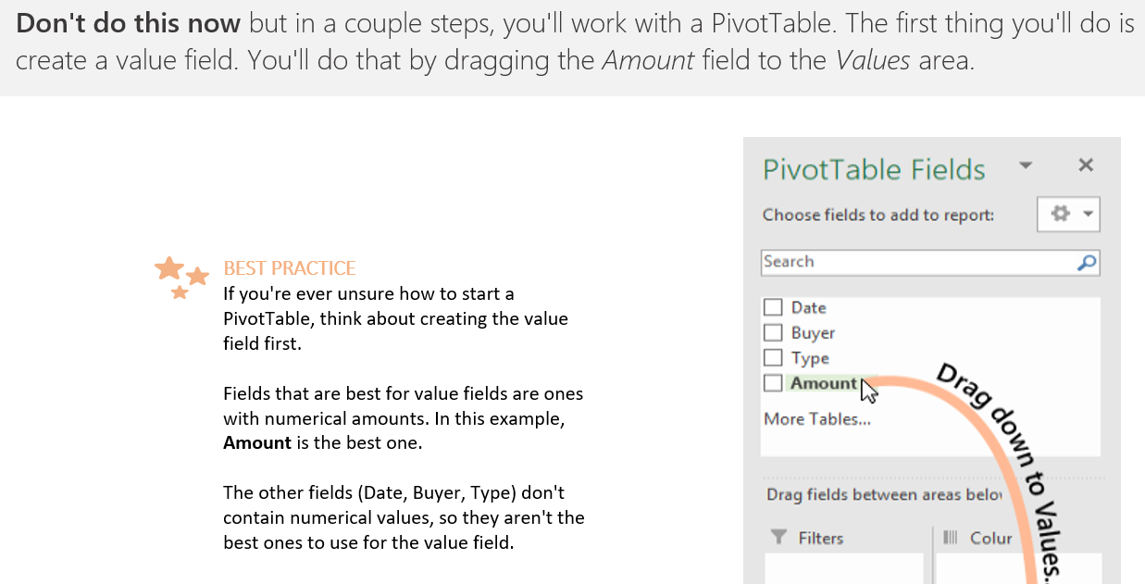
Drag Ins

Slide 26
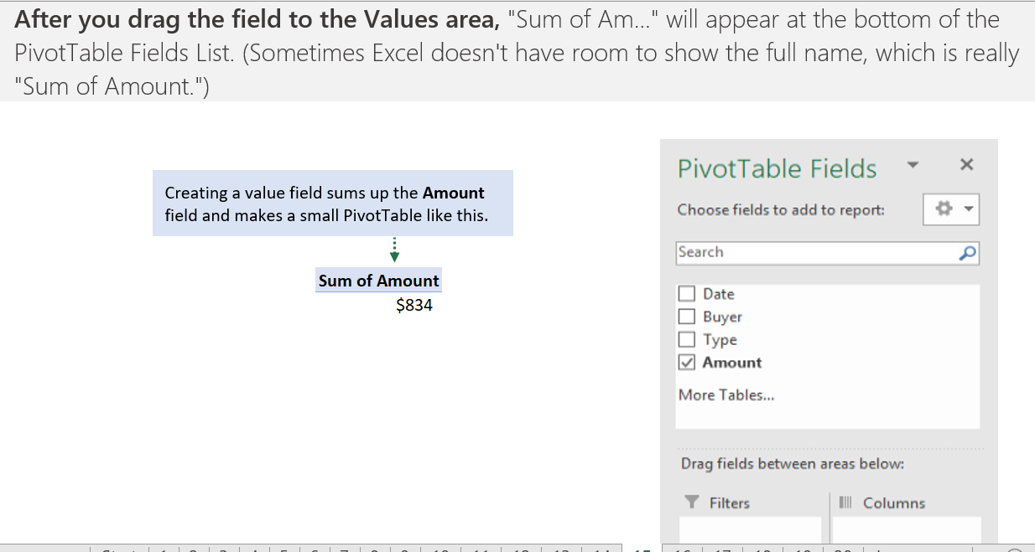
Sum Up

Slide 27
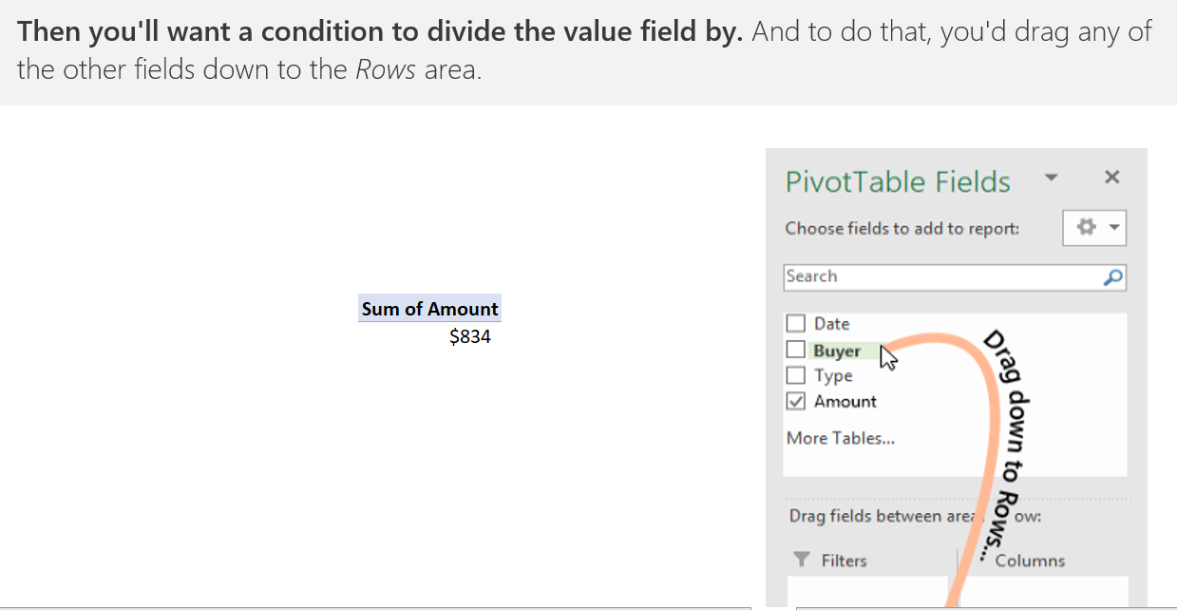
Drag Downs

Slide 28
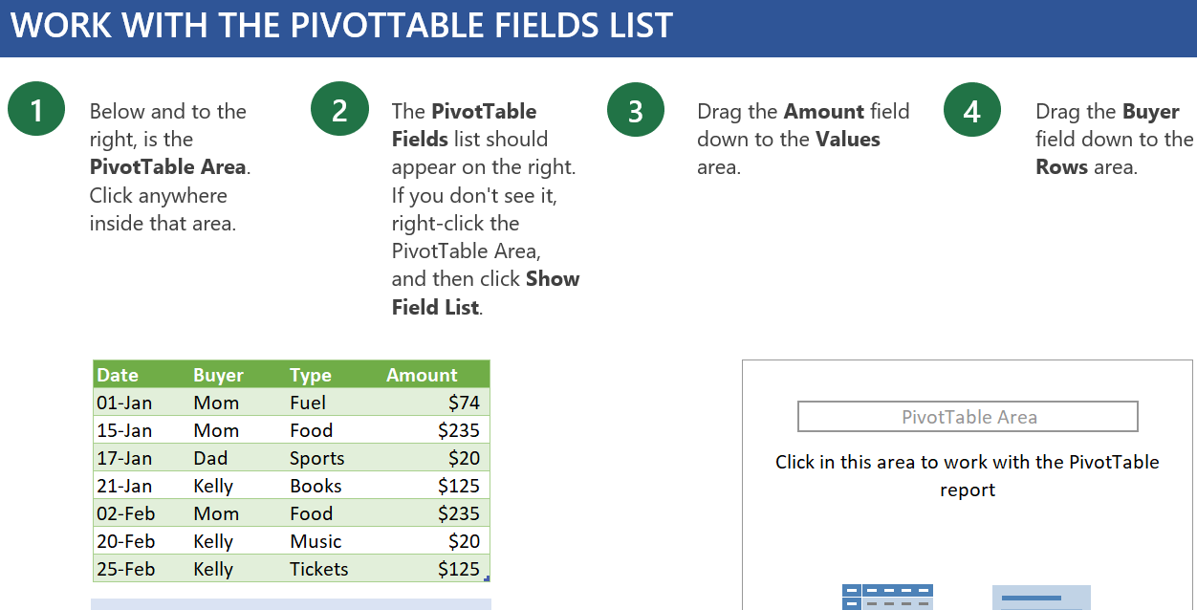
Right Click

Slide 29
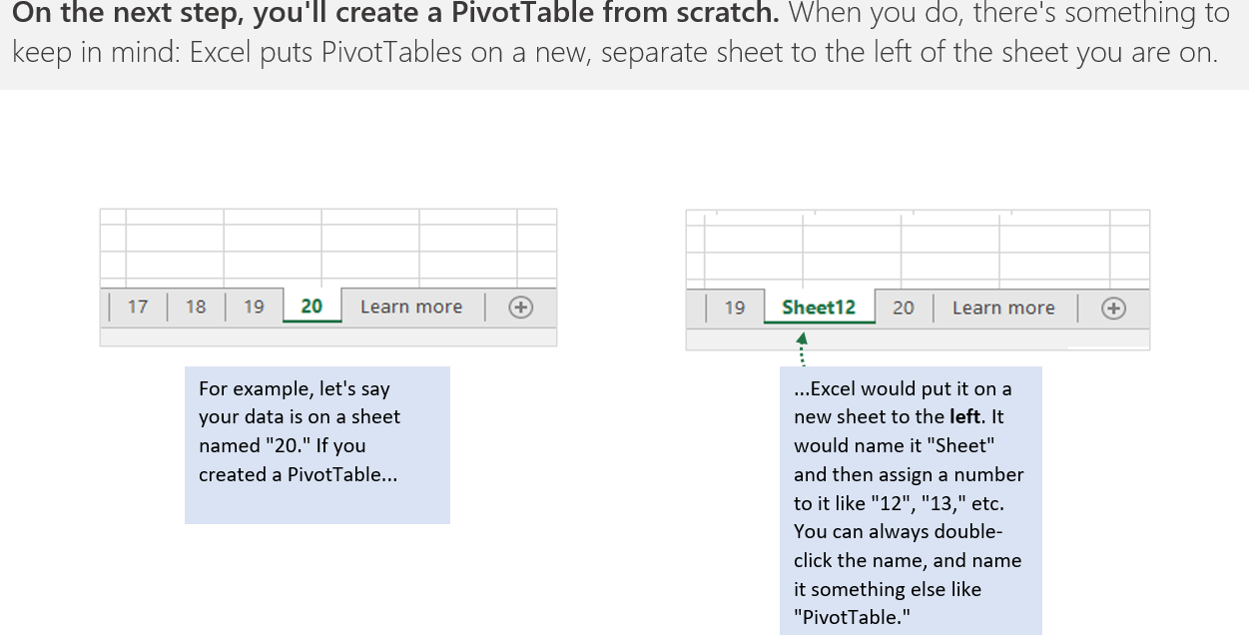
New Sheet Position

Slide 30
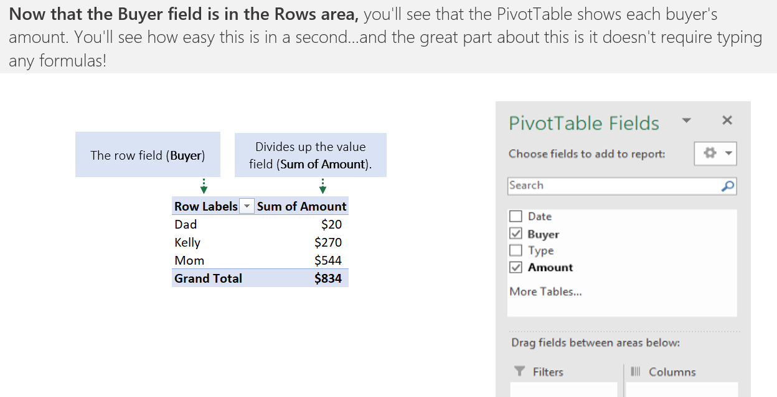
Selected both Fields

Slide 31
Pivot Table Charts

Slide 32
Assignment
Discussion Q&A

