Slide 1
Bertha Cabrera
Preview of Trainings

Slide 2
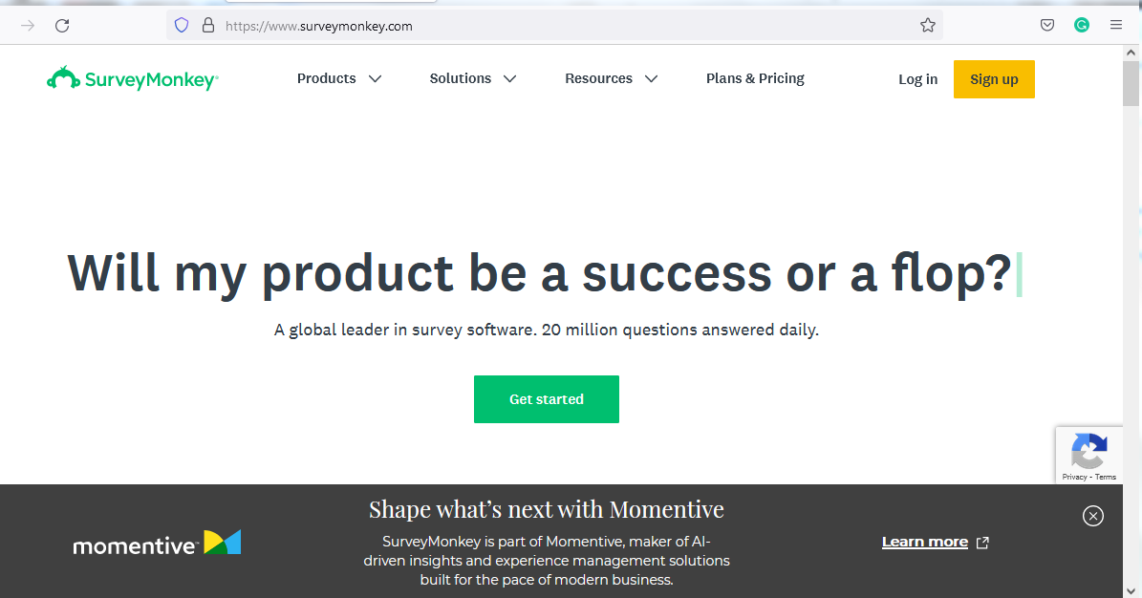
SurveyMonkey
https://www.surveymonkey.com/

Slide 3
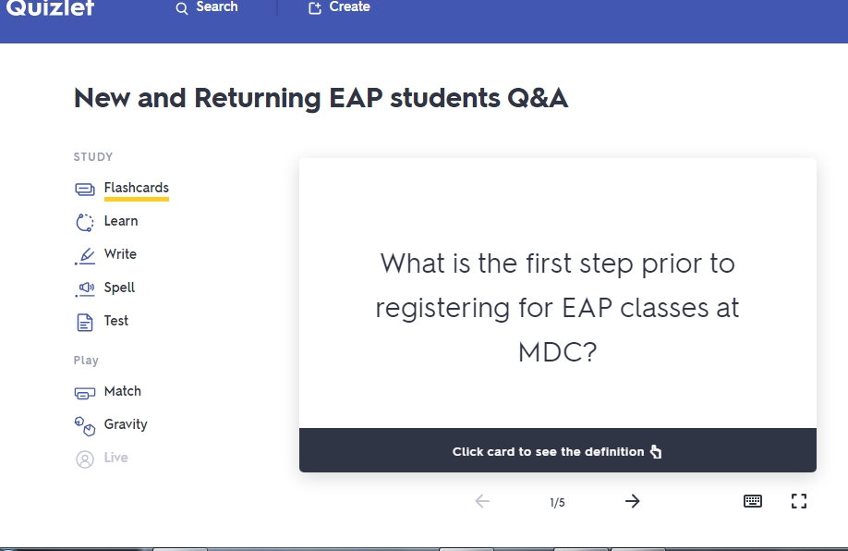
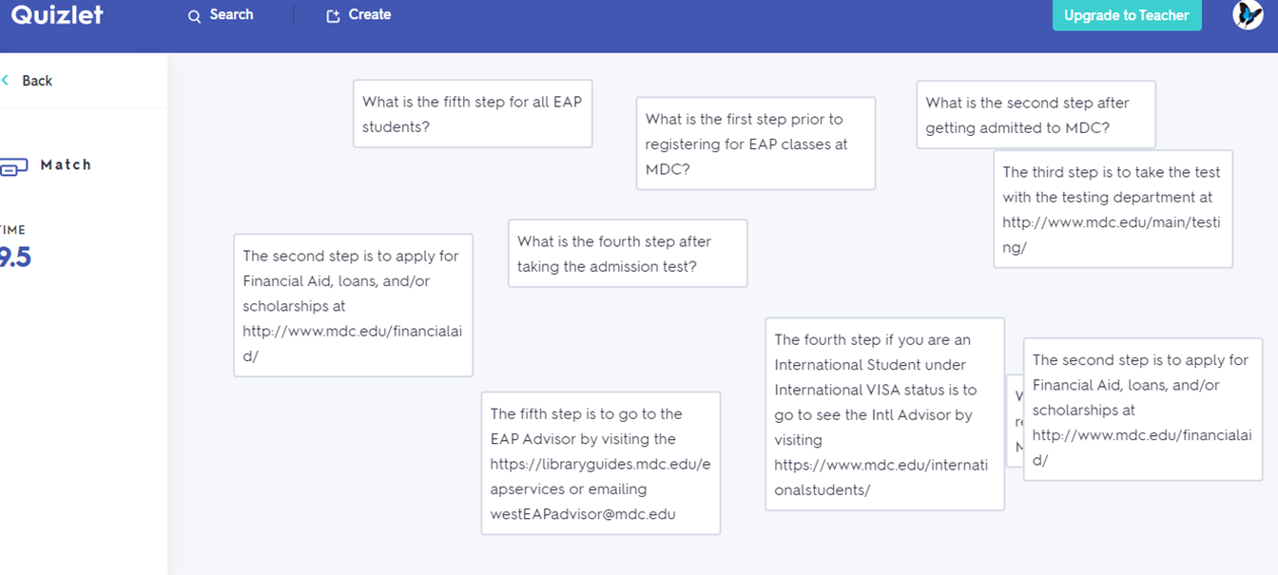
Quizlet
https://quizlet.com/520310403/new-and-returning-eap-students-qa-flash-cards/?new

Slide 4
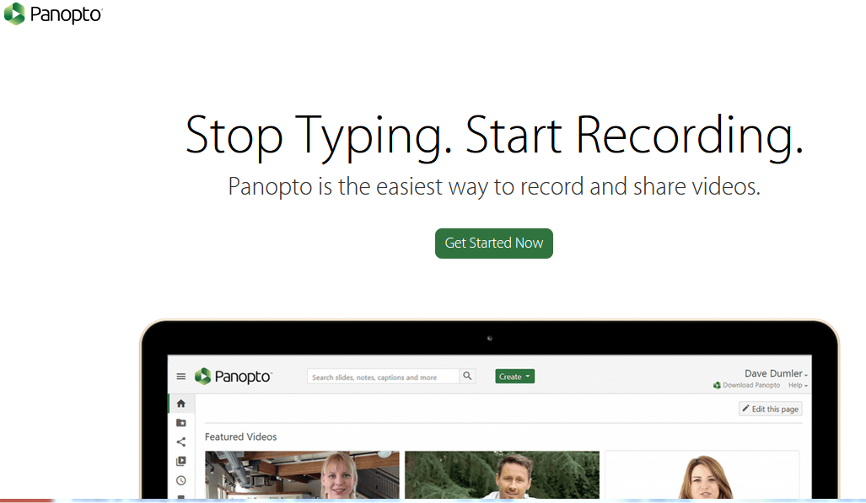
Panopto
https://www.panopto.com/

Slide 5
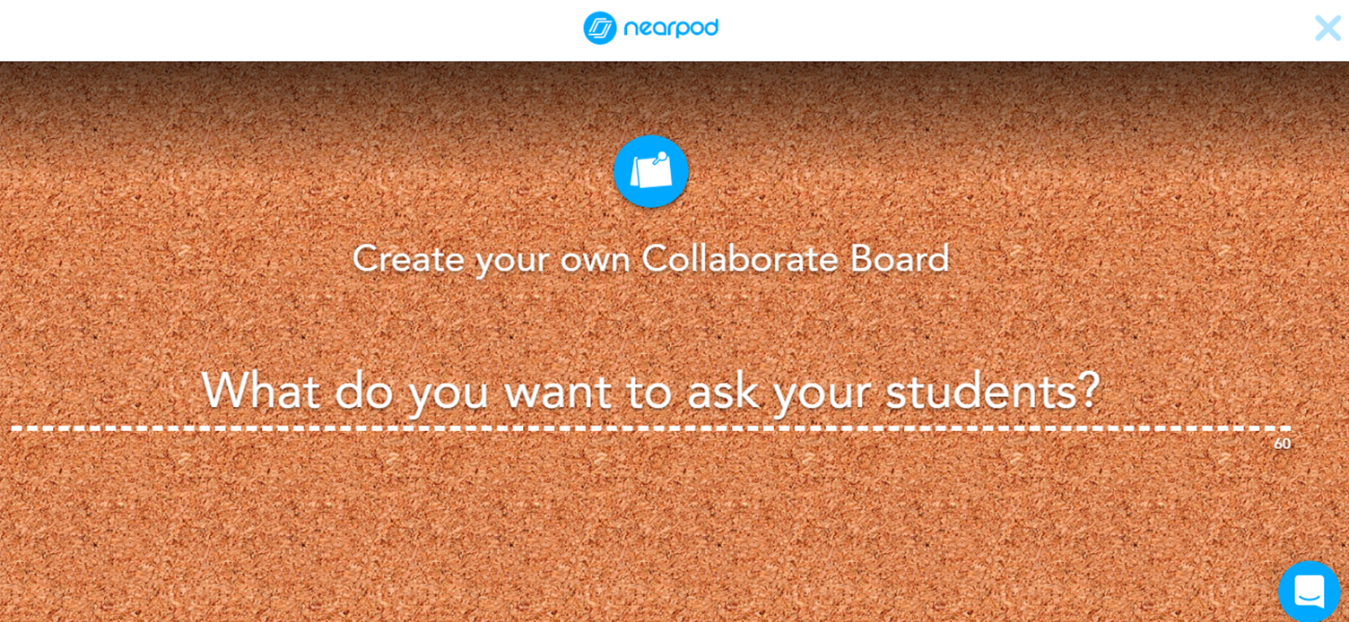
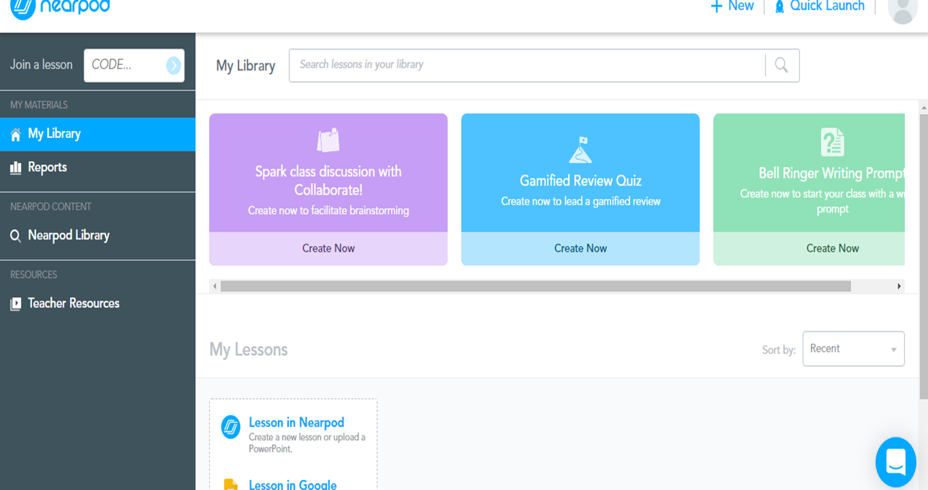
Nearpod Make every lesson interactive

Slide 6
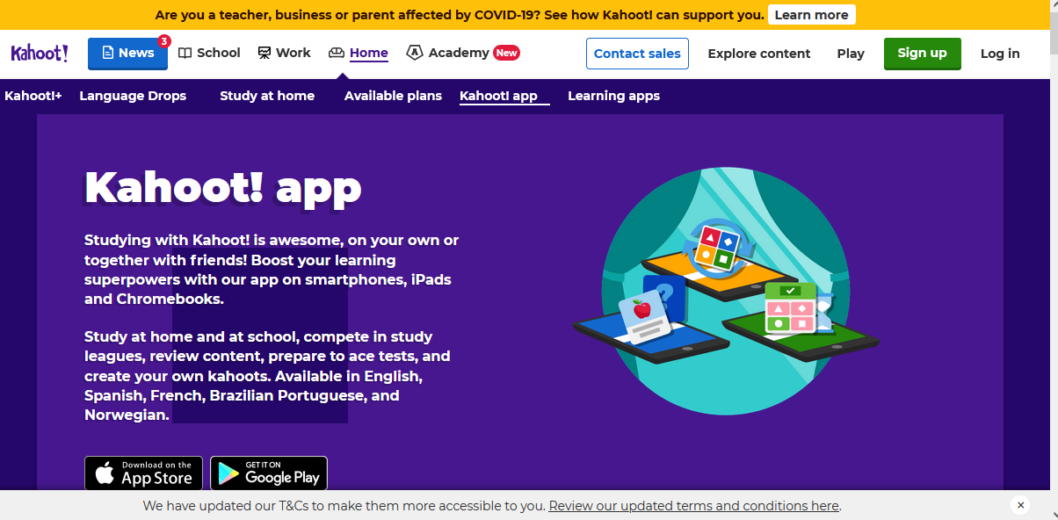
Kahoot Mobile-App
https://kahoot.com/home/mobile-app/

Slide 7
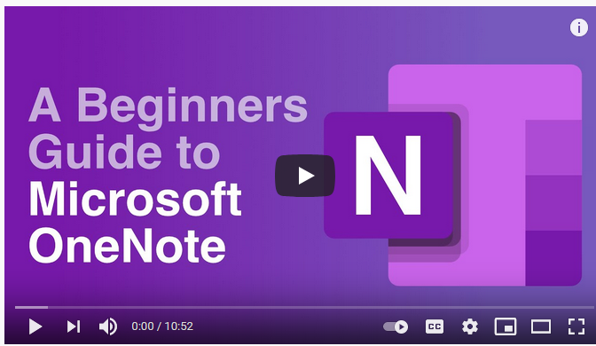
OneNote A Beginners Guide to MS OneNote
https://www.youtube.com/watch?v=JEJZbjcMkeU

Slide 8
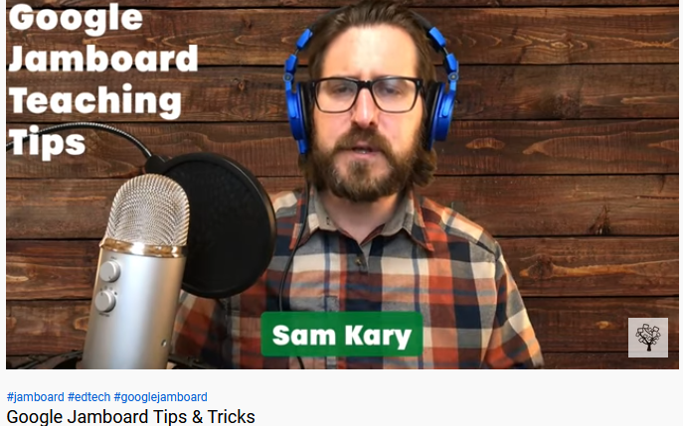
Jamboard tips & tricks
https://www.youtube.com/watch?v=KDlNcgmqc5c

Slide 9
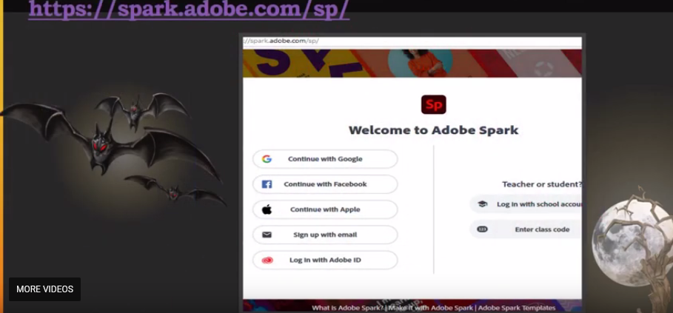
SparkAdobe Intro

Slide 10
LibGuide
https://libraryguides.mdc.edu/

